Slide 1
Computer Operating System Concepts

Slide 2
Deadlocks
Chapter Eight

Slide 3
Table of Content
Introduction
Deadlock Characterization
Methods for Handling Deadlocks
Deadlock Prevention
Recovery from Deadlock

Slide 4
introduction

Slide 5
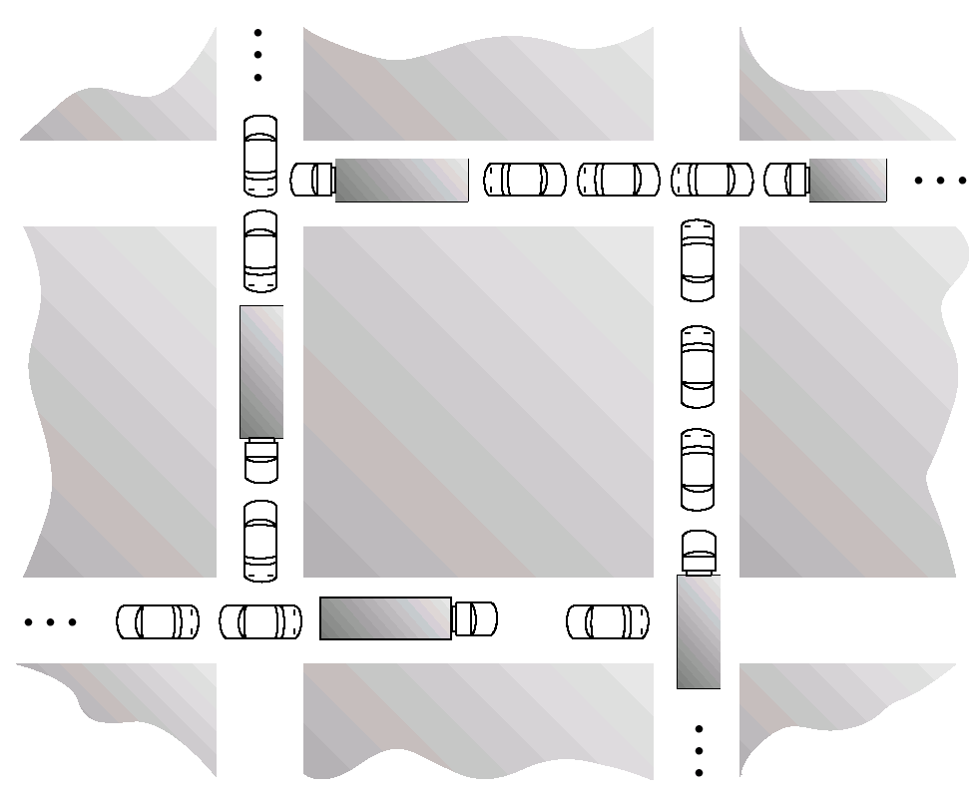
Is this Deadlock?

Slide 6
The Deadlock Problem
A set of blocked processes each holding a resource and waiting to acquire a resource held by another process in the set.
Example
System has 2 tape drives.
P1 and P2 each hold one tape drive and each needs another one.
semaphores A and B, initialized to 1
P1 P2
wait (A); wait(B)
wait (B); wait(A)

Slide 7
Bridge Crossing Example
Traffic only in one direction.
Each section of a bridge can be viewed as a resource.
If a deadlock occurs, it can be resolved if one car backs up (preempt resources and rollback).
Several cars may have to be backed up if a deadlock occurs.
Starvation is possible

Slide 8
Deadlock Characterization

Slide 9
Deadlock Characterization
Deadlock can arise if four conditions hold simultaneously.
Mutual exclusion: only one process at a time can use a resource.
Hold and wait: a process holding at least one resource is waiting to acquire additional resources held by other processes.
No preemption: a resource can be released only voluntarily by the process holding it, after that process has completed its task.
Circular wait: there exists a set {P0, P1, …, P0} of waiting processes such that P0 is waiting for a resource that is held by P1, P1 is waiting for a resource that is held by P2, …, Pn–1 is waiting for a resource that is held by Pn, and P0 is waiting for a resource that is held by P0

Slide 10
Resource-Allocation Graph
Process
Resource Type with 2 instances
Pi requests instance of Rj
Pi is holding an instance of Rj
Rj
Pi
Rj
Pi

Slide 11
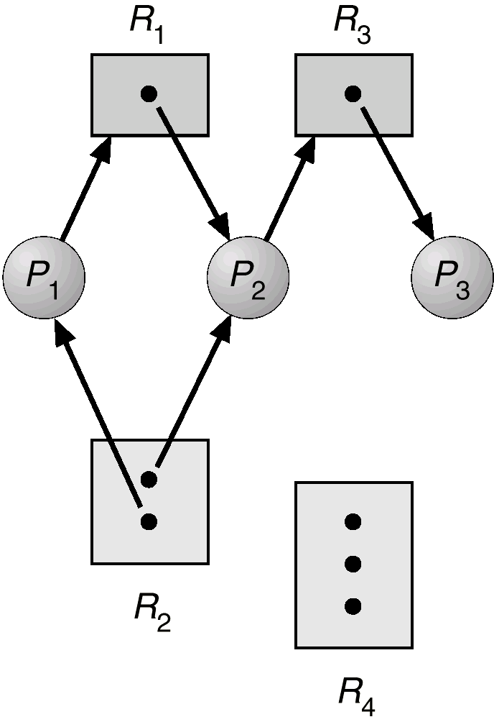
Example of a Resource Allocation Graph

Slide 12
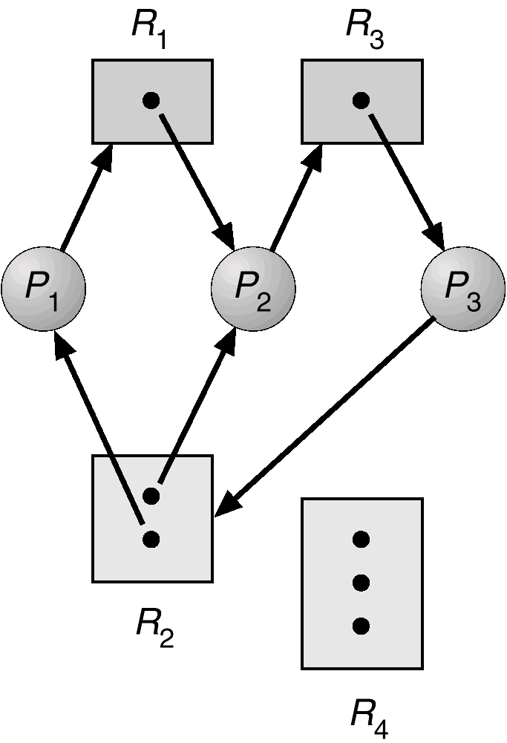
Resource Allocation Graph With A Deadlock

Slide 13
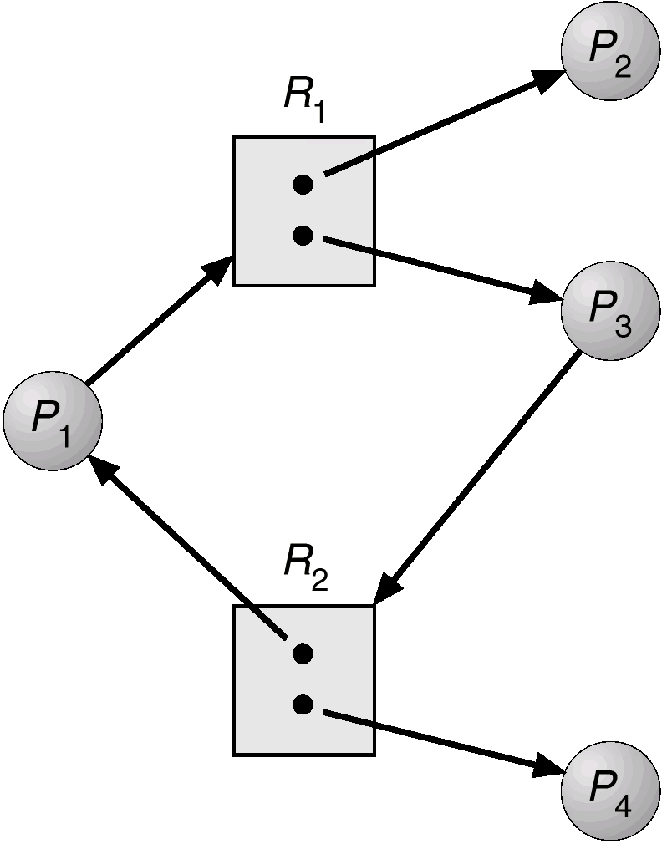
Resource Allocation Graph With A Cycle But No Deadlock

Slide 14
Basic Facts
If graph contains no cycles no deadlock.
If graph contains a cycle
if only one instance per resource type, then deadlock.
if several instances per resource type, possibility of deadlock.

Slide 15
Methods for Handling Deadlocks

Slide 16
Methods for Handling Deadlocks
Ensure that the system will never enter a deadlock state.
Allow the system to enter a deadlock state and then recover.
Ignore the problem and pretend that deadlocks never occur in the system; used by most operating systems, including UNIX.

Slide 17
Deadlock Prevention

Slide 18
Deadlock Prevention
Mutual Exclusion
Not required for sharable resources; must hold for non-sharable resources.
Hold and Wait
must guarantee that whenever a process requests a resource, it does not hold any other resources.
Require process to request and be allocated all its resources before it begins execution, or allow process to request resources only when the process has none.
Low resource utilization; starvation possible.

Slide 19
Deadlock Prevention Cont’d
No Preemption
If a process that is holding some resources requests another resource that cannot be immediately allocated to it, then all resources currently being held are released.
Preempted resources are added to the list of resources for which the process is waiting.
Process will be restarted only when it can regain its old resources, as well as the new ones that it is requesting.
Circular Wait
Impose a total ordering of all resource types, and require that each process requests resources in an increasing order of enumeration.

Slide 20
Recovery from Deadlock

Slide 21
Recovery from Deadlock
Abort all deadlocked processes.
Abort one process at a time until the deadlock cycle is eliminated.
In which order should we choose to abort?
Priority of the process.
How long process has computed, and how much longer to completion.
Resources the process has used.
Resources process needs to complete.
How many processes will need to be terminated.
Is process interactive or batch?

Slide 22
Recovery from Deadlock: Resource Preemption
Selecting a victim
minimize cost.
Rollback
return to some safe state, restart process for that state.
Starvation
same process may always be picked as victim, include number of rollback in cost factor.

